Slide 1

EditEdit MasterMaster texttext stylesstyles
Practical Lecture 5: Class and Object

Slide 2

Quick Recap
Let’s take a quick recap of previous lecture –
A)
B)
C)
D)
E)

Slide 3
Today’s Agenda
Today we are going to cover -
Class
Object
Explaining class and object with example
Creating class function inside the class.
Creating Class function Outside the class
Practice Questions

Slide 4
C++
Let’s Get Started-

Slide 5
Class and Object
A class in C++ is the building block, that leads to Object-Oriented programming. It is a user-defined data type, which holds its own data members and member functions, which can be accessed and used by creating an instance of that class. A C++ class is like a blueprint for an object.
An Object is an instance of a Class. When a class is defined, no memory is allocated but when it is instantiated (i.e. an object is created) memory is allocated

Slide 6
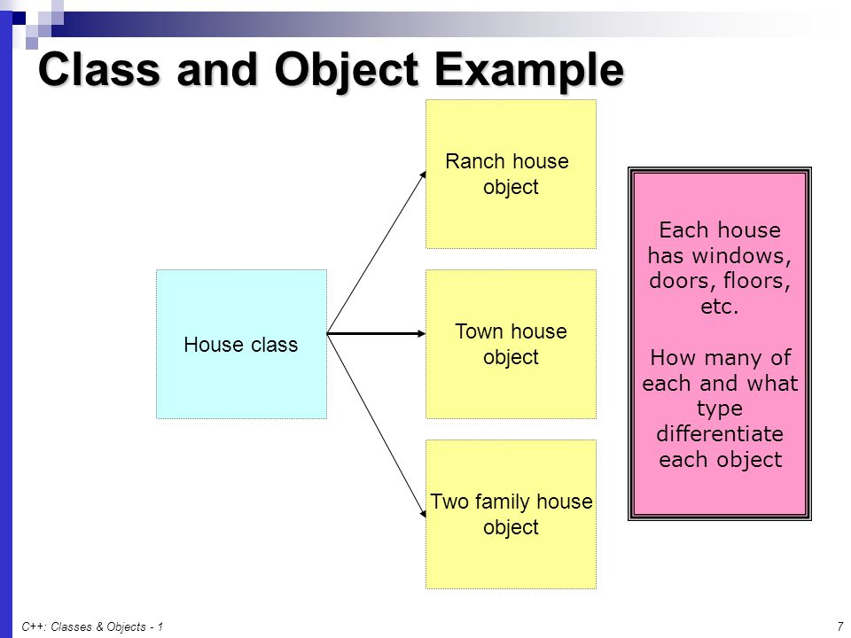
Class and Object Example

Slide 7
Class and Object example
#include <iostream>
#include<string>
using namespace std;
class Student{ // we are creating class with class keyword
public: //Access modifiers
string studentName; //Data members of the class
int rollNumber;
int tutionFess;
};

Slide 8
Class and Object example
int main() {
Student studentOne; // creating object of student class
studentOne.studentName="Vikash";
studentOne.rollNumber=55;
studentOne.tutionFess=400000.00;
cout<<"The student name is"<<" "<<studentOne.studentName<<endl; // endl is used for the next line
cout<<"The student roll number is"<<" "<<studentOne.rollNumber<<endl;
cout<<"The student tution fees is"<<" "<<studentOne.tutionFess<<endl;
}

Slide 9
Class and Object example
Output
The student name is Vikash
The student roll number is 55
The student tution fees is 400000

Slide 10
Creating multiple object for the class
#include <iostream>
#include<string>
using namespace std;
class Student{ // we are creating class with class keyword
public: //Access modifiers
string studentName; //Data members of the class
int rollNumber;
int tutionFees;
};

Slide 11
Creating multiple object for the class
int main() {
Student studentOne; // creating object of student class
studentOne.studentName="Vikash";
studentOne.rollNumber=55;
studentOne.tutionFees=400000.00;
cout<<"The student name is"<<" "<<studentOne.studentName<<endl; // endl is used for the next line
cout<<"The student roll number is"<<" "<<studentOne.rollNumber<<endl;
cout<<"The student tution fees is"<<" "<<studentOne.tutionFees<<endl;

Slide 12
Creating multiple object for the class
Student studentTwo; // creating object of student class
studentTwo.studentName="Mukesh";
studentTwo.rollNumber=44;
studentTwo.tutionFees=500000.00;
cout<<"The student name is"<<" "<<studentTwo.studentName<<endl; // endl is used for the next line
cout<<"The student roll number is"<<" "<<studentTwo.rollNumber<<endl;
cout<<"The student tution fees is"<<" "<<studentTwo.tutionFees<<endl;
}

Slide 13
Output
The student name is Vikash
The student roll number is 55
The student tution fees is 400000
The student name is Mukesh
The student roll number is 44
The student tution fees is 500000

Slide 14
Creating Function Inside the class
class Student{ // we are creating class with class keyword
public: //Access modifiers
string studentName; //Data members of the class
int rollNumber;
int tutionFees;
void studentInfoDisplay(){
cout<<"The student name is"<<" "<<studentName<<endl; // endl is used for the next line
cout<<"The student roll number is"<<" "<<rollNumber<<endl;
cout<<"The student tution fees is"<<" "<<tutionFees<<endl;
}
};

Slide 15
Creating Function inside the class
int main() {
Student studentOne; // creating object of student class
studentOne.studentName="Vikash";
studentOne.rollNumber=55;
studentOne.tutionFees=400000.00;
studentOne.studentInfoDisplay();
}

Slide 16
Creating function outside the class
#include <iostream>
#include<string>
using namespace std;
class Student{ // we are creating class with class keyword
public: //Access modifiers
string studentName; //Data members of the class
int rollNumber;
int tutionFees;
void studentInfoDisplay();
};

Slide 17
Creating function outside the class
void Student :: studentInfoDisplay(){ // methods defined outside the class
cout<<"The student name is"<<" "<<studentName<<endl; // endl is used for the next line
cout<<"The student roll number is"<<" "<<rollNumber<<endl;
cout<<"The student tution fees is"<<" "<<tutionFees<<endl;
}

Slide 18
Creating function outside the class
int main() {
Student studentOne; // creating object of student class
studentOne.studentName="Vikash";
studentOne.rollNumber=55;
studentOne.tutionFees=400000.00;
studentOne.studentInfoDisplay();
}

Slide 19
Practice Questions
Write a C++ Program to find Factorial of a number using class. Here’s simple C++ Program to find Factorial of a number using class in C++ Programming Language.
2. Write a C++ Program to find Sum of odd numbers between 1 and 100 using class

Slide 20
Practice Questions
3.Write a C++ Program To Calculate Electricity Bill Of Person using Class. Here’s a Simple Program To Calculate Electricity Bill Of Person using Class in C++ Programming Language
To Calculate Electricity Bill Of Person using Class,first we have to create and call get() function to take input details of the customer.
After get( ) , we create and call a new function i.e calc_bill( ) to calculate the total bill of the customer on the behalf of units consumed by the customer .
At last , we call the put( ) function to print or display customer or person electricity bill on the screen.
100 RS. 1.20 per unit
200 RS. 2 per unit
300 RS. 3 per unit

Slide 21

QNA Time
Any Questions??
Any Questions ??

Slide 22
Thank You!
See you guys in next class.

